Slide 1
NPLEX 1 Information Session
April 12, 2016

Slide 2
Agenda
NPLEX I – Introduction
Application process
NPLEX I – General trends and lessons learned
Prep courses and resources
Study strategies
Student experiences and feedback

Slide 3
NPLEX I
NPLEX tests the Basic sciences
Stem with multiple associated questions
Categories are:
Structure and function:
Anatomy, physiology, biochemistry, embryology
Disease and dysfunction:
Microbiology, immunology, genetics, pathology
August 2
2 sections at 2.5 hours each; 100 exam items per section

Slide 4
Cost of NPLEX I
Cost
$175 Exam Administration Fee
$300 Biomedical Science Exam Fee
$612.22 Canadian (as of April 11, 2016)
Study hours: 100-200 hours
Application: May 1-31, 2016
Exam date: August 2, 2016

Slide 5
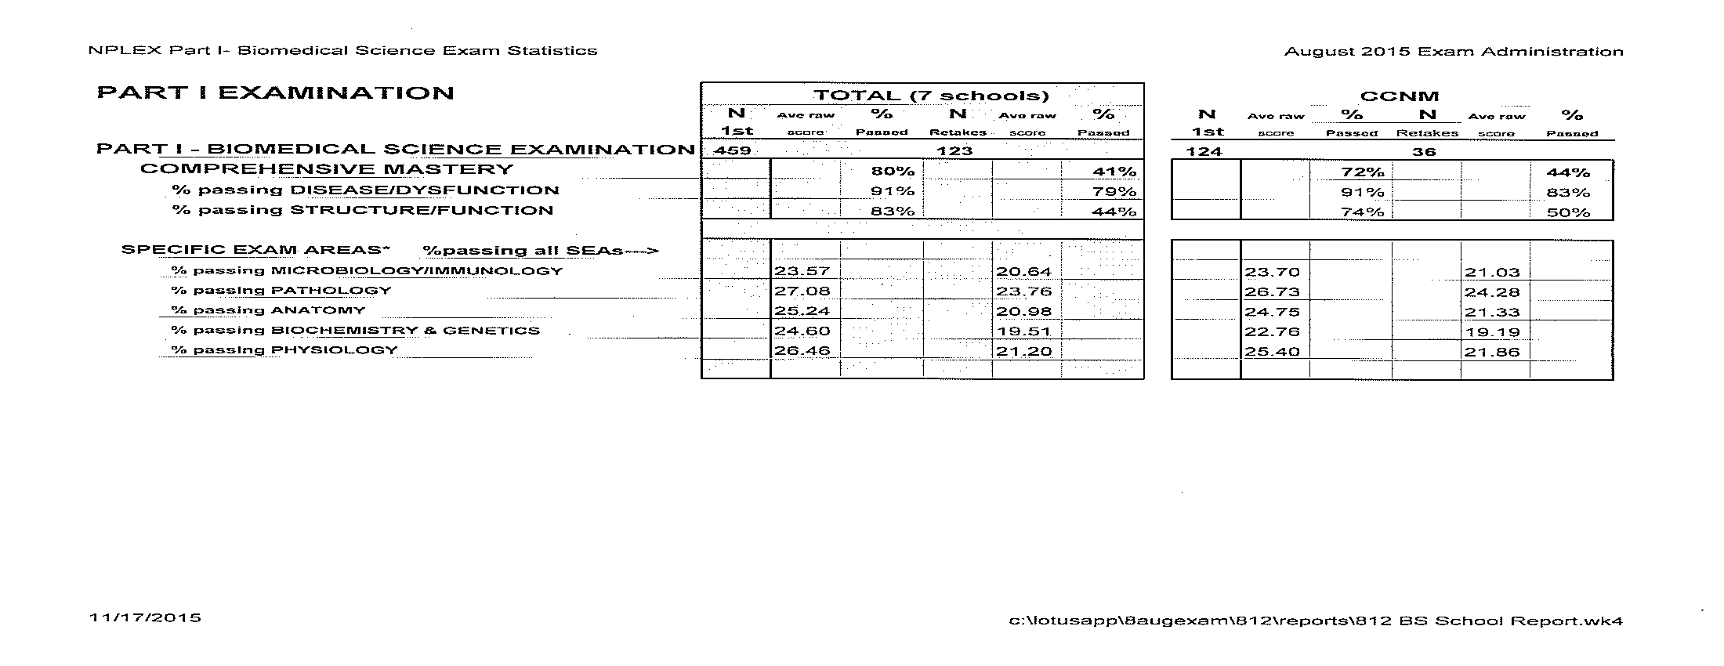

Slide 6
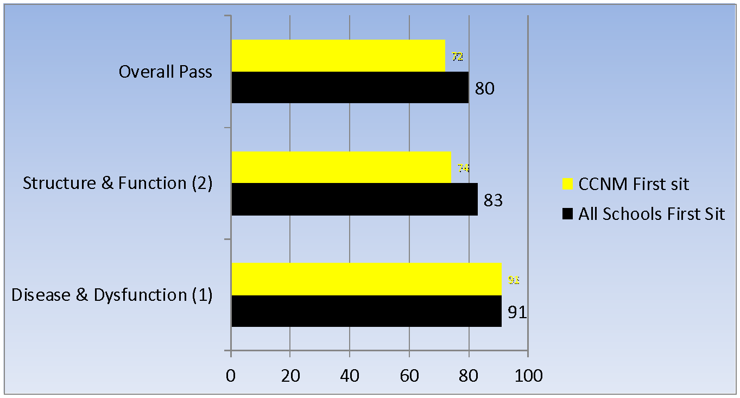
August 2015 NPLEX Passing Rates
Microbiology, Immunology and Pathology. Anatomy, Physiology, Biochemistry and Genetics.

Slide 8
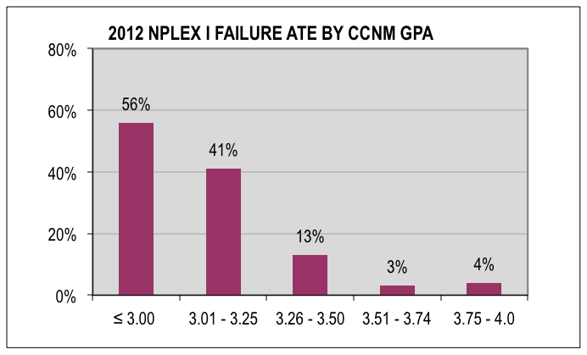
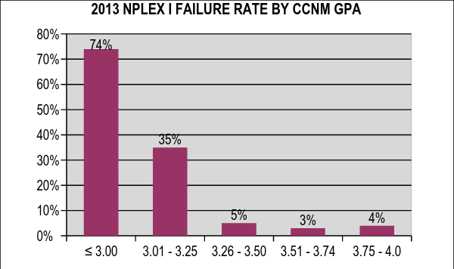
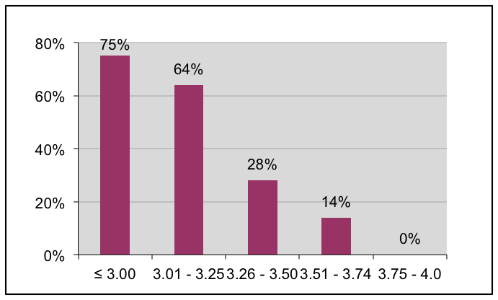
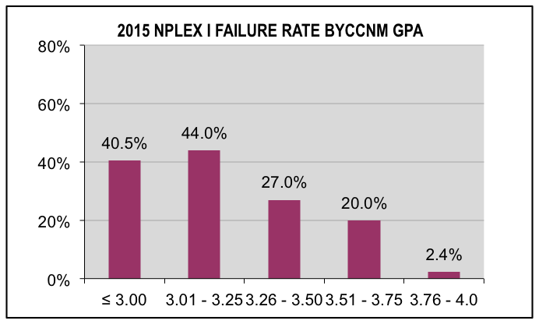
NPLEX I FAILURE RATE BY CCNM GPA 2012-2015
2014 NPLEX I FAILURE RATE BY CCNM GPA

Slide 9
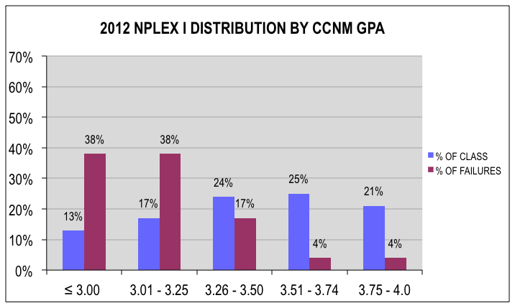
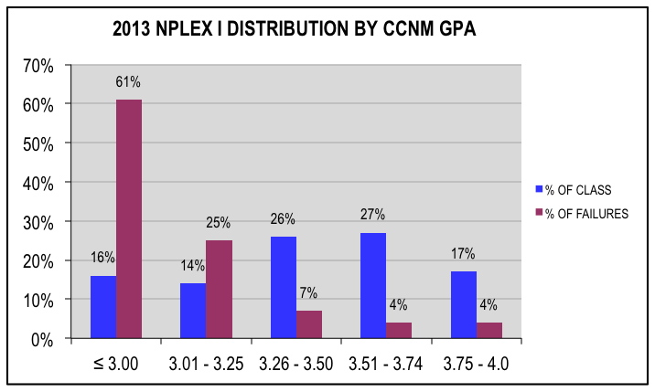
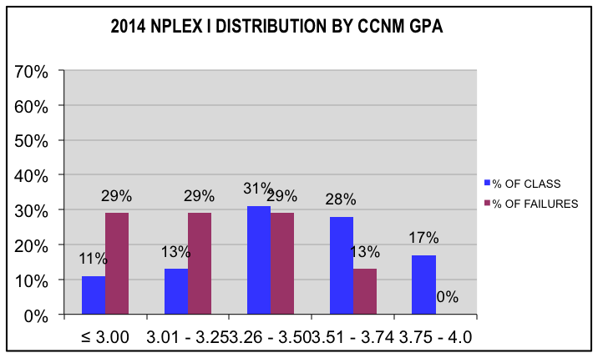
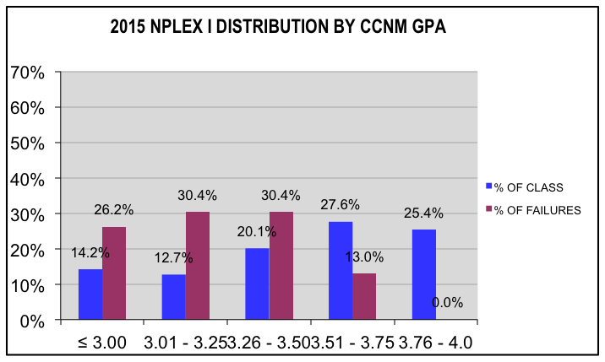
NPLEX I DISTRIBUTION BY CCNM GPA 2012-2015

Slide 10
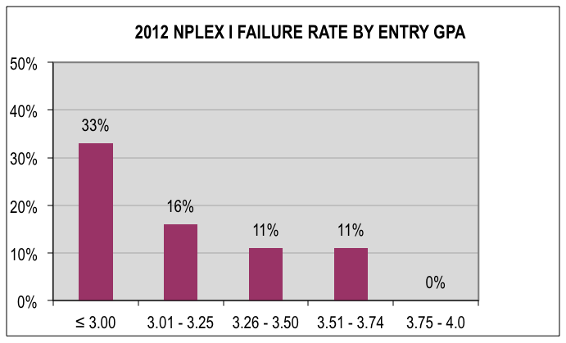
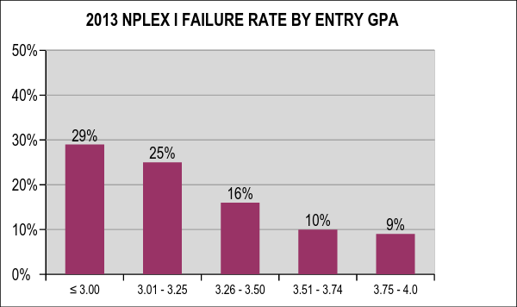
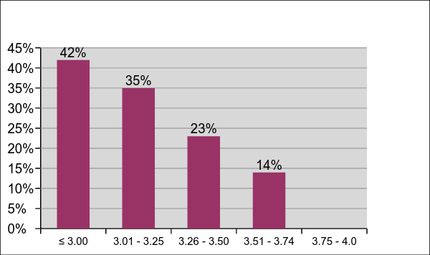
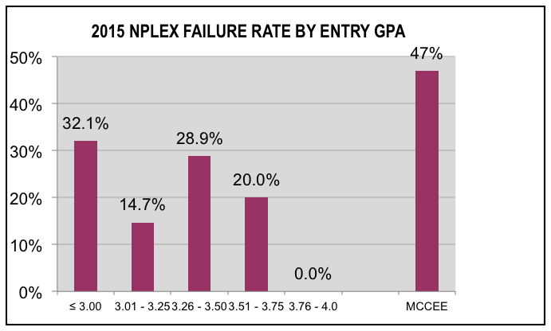
NPLEX I FAILURE RATE BY ENTRY GPA 2012-2015
2014 NPLEX I FAILURE RATE BY ENTRY GPA

Slide 11
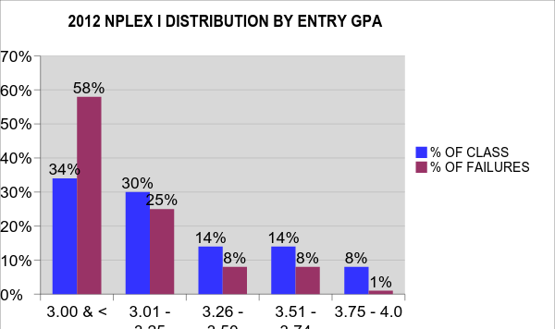
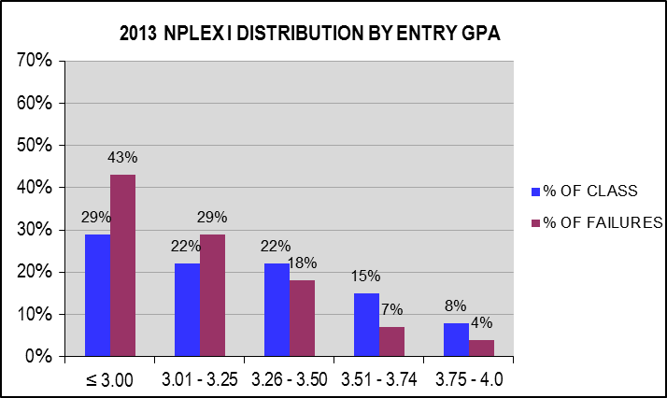
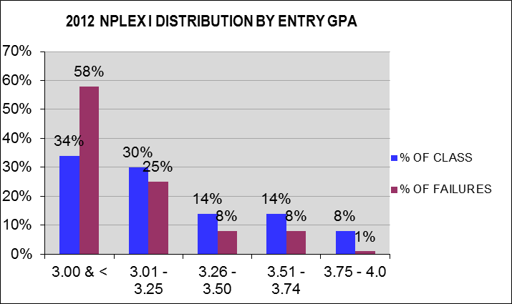
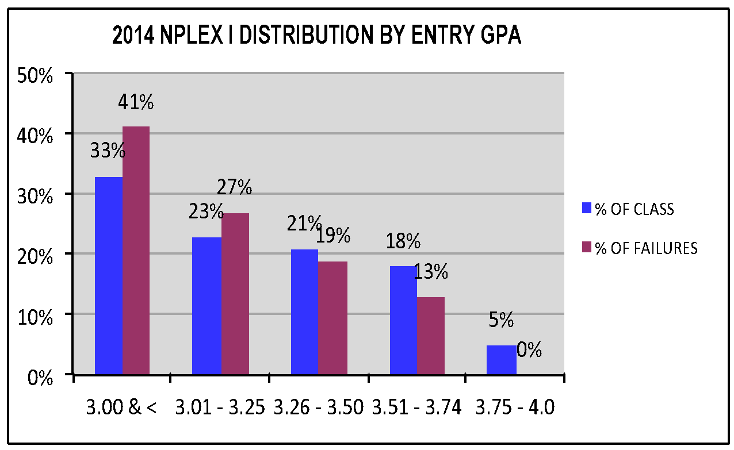
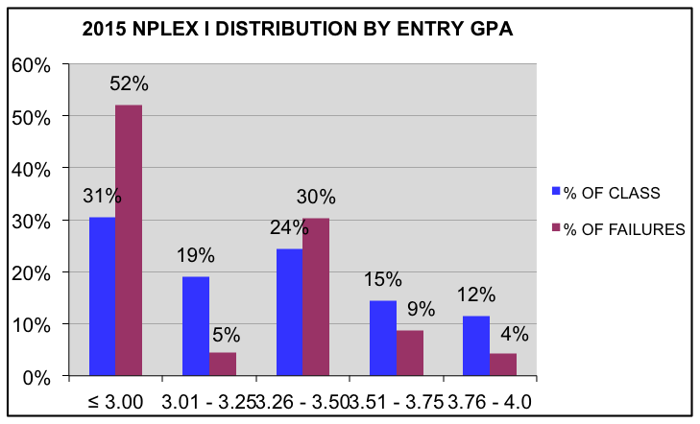
NPLEX I DISTRIBUTION BY ENTRY GPA 2012-2015

Slide 12
Interviews
25 individuals were invited to interview based on a CCNM GPA of 3.10 or higher; 15 met with us
Backgrounds ranged from BSc Hons (2), students, BSc (8), BA (1), BA Hons (1), MCCEE (3)

Slide 13
Interview Results
Many students who failed did not invest a sufficient number of hours in studying (many studied for only 3 weeks)
Did not expect the level of detail on the exam
50% expected to pass
Around 50% of the IMG cohort failed to pass the exam. This accounts for approximately 10% of the students that failed
There continues to be support from students not to teach to the exam but rather to focus the curriculum on graduating good clinicians

Slide 14
Prevention
# Hours Spent Studying | Pass | Fail
Less than 50 hours | 3% | 17%
51-100 hours | 31% | 58%
101-200 | 38% | 8%
200 or more | 28% | 17%

Slide 15
Recommendations (for CCNM)
Consider offering structured biochemistry, anatomy, immunology, and embryology/genetics refresher course(s), especially for IMG students
Work with Structure/Function faculty in particular to determine how to better support students in writing the exam
Consider how foundational knowledge can be reinforced throughout the first two years of the program rather than simply forgotten after the student has passed the exam testing that particular knowledge
Consider how/whether to make exams more “NPLEx-style” or prep course with NPLEX mock exams
Start talking with students about NPLEx in Year 1 so they can be preparing their notes and resources on an ongoing basis
Support more faculty in writing questions for NPLEX

Slide 16
Recommendations (for students)
Don’t underestimate the time required to study for this exam (at least a month of 12+ hours/week)
Note that prep courses focus on key concepts but don’t teach to the level of detail that will be tested on the exam. The prep courses are a great starting point, but you must use more resources and dig much more deeply into the detail.
Be realistic. This is an expensive exam. If you can reasonably foresee that you won’t have sufficient time to study for the exam, don’t sign up for it. You don’t need a trial run in order to pass the exam; you do need to put in the time.
Organizing tips
Study tips:
You cannot cram for this exam. There is too much material.

Slide 17
Available Resources
Preparatory Courses:
Dr. J. Grossman http://www.drjaygrossman.com/national-board-review-exams.html
Dr. P. Anderson http://www.ccnm.edu/content/nplex-1-prep-course-aug-2016
Study support
Dr. Belus and Dr. ? NPLEX Crunch http://www.nplexcrunch.com/
Dr. C. Habib http://passnplex.com/
Independent Study (books)
USMLE Resource (First Aid)
Wild Brilliance Press (formerly Healing Mountain)
Websites/Exams
Pathoma http://www.pathoma.com/

Slide 18
Study strategies

Slide 19
Student feedback

Slide 20
Cost of NPLEX I
Cost
$175 Exam Administration Fee
$300 Biomedical Science Exam Fee
$612.22 Canadian (as of April 11, 2016)
Study hours: 100-200 hours
Application: May 1-31, 2016
Exam date: August 2, 2016
Passing NPLEX I the first time - Priceless

Slide 21
Key messages
Put in the time
Don’t underestimate amount of detail you need to know (except ddx)
Stick to a schedule
Doing it again costs you more than $
Embrace the challenge
You can do it!

